Slide 1
Test/Control – Module 3 Synthetic Controls

Slide 2
Discuss Synthetic Control Concepts and Examples from Dr. Alberto Abadie’s Presentation
https://csml.princeton.edu/sites/g/files/toruqf911/files/documents/Abadie_SCM_6-2022.pdf

Slide 3
CVS Example – Application of Synthetic Control to understand impact of Merck’s CVS GAP Tool Investments

Slide 4
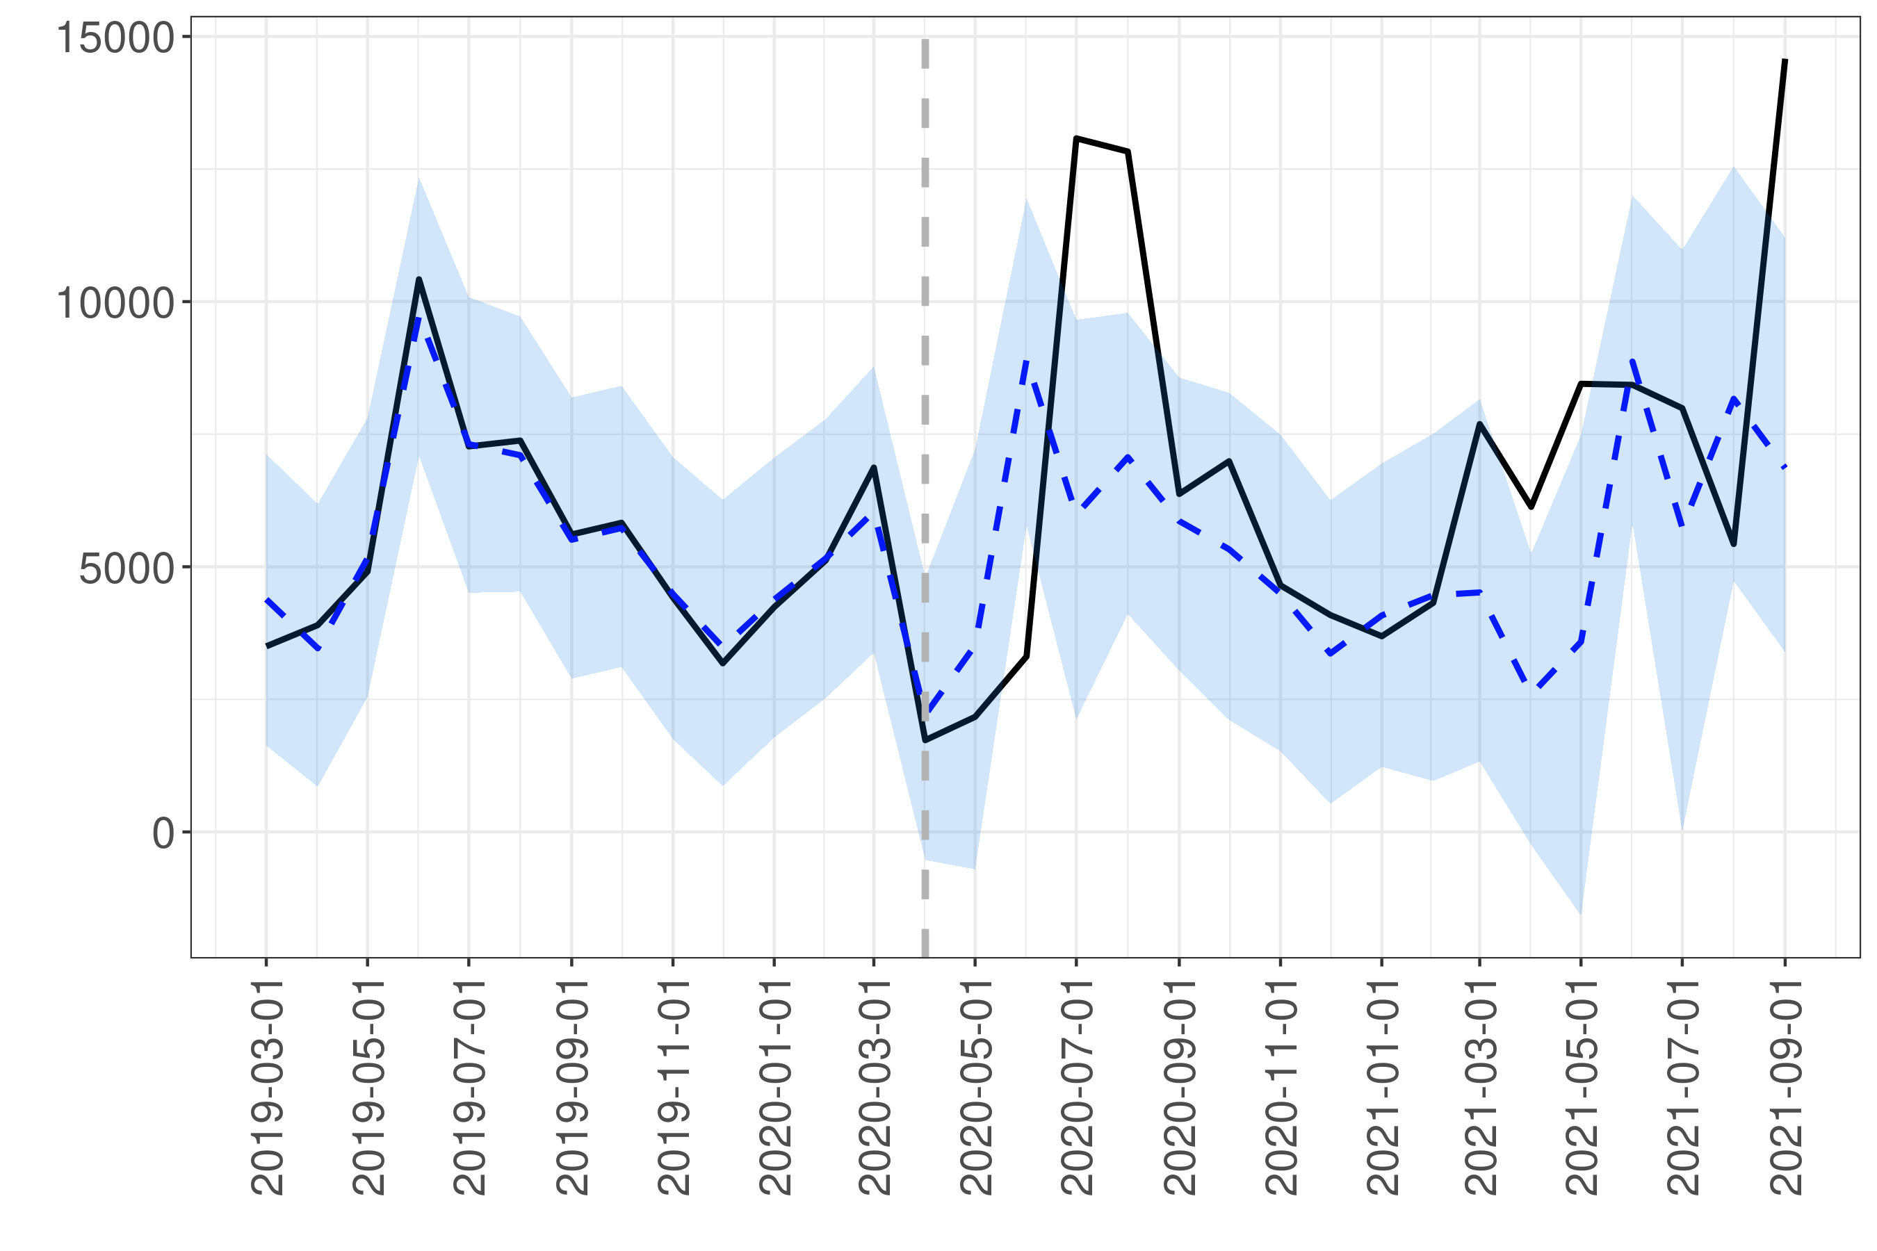
CVS Gap Tool Impact
Gap Tool Online
Lower End (500 doses/month): $1.1 in yearly incr. revenue (accounting for seasonality)
Upper End (1100 doses/month): $2.4 in yearly incr. revenue
Synthetic Control
CVS
Doses
Causal Impact: leverages the value of the target (CVS doses) pre “intervention” along with similar data streams (i.e., other pharmacy dose patterns) without the “intervention” (i.e., the tool) to create a synthetic control
Synthetic Control: how would doses in CVS have evolved if the gap tool didn’t exist?
Pre-Intervention
Post-Intervention
*yearly estimates based on 2021 dose pricing

Slide 5
Causal Inference Materials from
Michael Johnson (Ex- IAIO team member)

